Slide 1
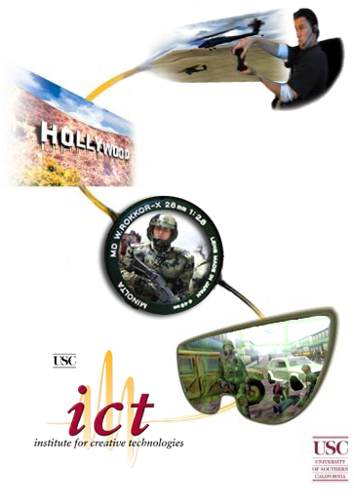
Integrating
Architecture
Michael van Lent
Institute for Creative Technology
University of Southern California

Slide 2
Motivation
Technologies at ICT have been chosen on a project-by-project basis.
  Pros
    Maximum flexibility for each project
    Experience with a wide-range of technologies
    Game industry technologies are used more and more
  Cons
    Inhibits integration of research
      with other research groups
      with prototype developers
      into the Army’s transition pipeline
    Increased and duplicated infrastructure effort
    No one is using the Army’s simulation systems
      don’t include immersive capabilities
      significant overhead in familiarization and integration

Slide 3
Solution:
The Integrating Architecture
A single technological foundation for ICT
  and other research & development groups
Core design principles
  Support research in:
    Artificial Intelligence
    Computer graphics
    Immersive audio
    Skeletal and facial animation
    Immersive training systems
  Pipeline from research to development to transition
  Custom-built to researcher’s needs
  Best-of-class technologies
  Free or inexpensive research licenses

Slide 4
Building the IA
GFY04
  Phase 1: Investigation
    Gather requirements from user community
    Survey current ICT technology landscape
    Evaluate existing candidate technologies
  Phase 2: Design
    Create a technical design document
    Create a development schedule
    Refine the budget
  Phase 3: Development
    Build part of the Integrating Architecture
    Produce a proof-of-concept demonstration
GFY05
  Phase 4: Continued development
    Ready for wide-spread use in October 2005
GFY06 and on
  Support and Integration Architecture 2.0

Slide 5
Phase 1: Requirements
Gather requirements from the user community
  ICT research groups
  External research groups
  Immersive training application developers
  Army modeling and simulation community
150 requirements in 14 categories
  General technical, platform, graphics, animation, sound, physics, AI, input, networking, runtime, content, world simulation, cost, vendor support

Slide 6
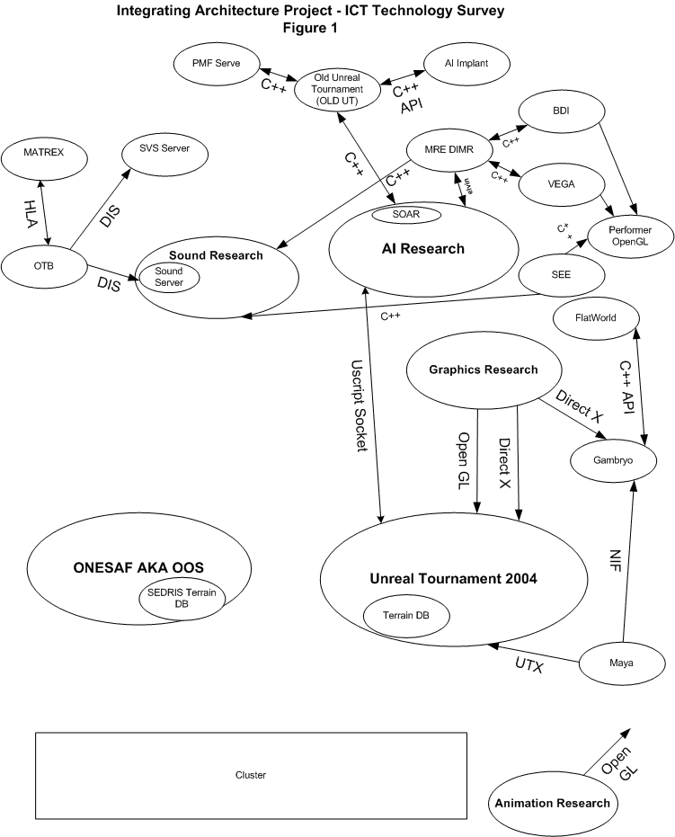

Slide 7
Phase 1: Evaluate Candidates
Game Engines/Virtual Environments
  Title-based: UT 2.5, Source, Quake, The Sims, There
  License-based: Renderware, Gamebryo, Jupiter
  Low cost/Free: Torque, Panda, Crystal Space, OGRE, SAGE, Full Spectrum Command
Virtual Environments
  VEGA, Performer
Middleware Tools
  Physics: Havok, Open Dynamics Engine, Renderware Physics
  Networking: Butterfly.net, Quazal…
  AI: AI.Implant, Renderware AI…
  Audio: Renderware Audio, Miles, OpenAL…
Military Simulation Systems
  OTB, OOS, MATREX, Janus, JVB, SoSILL, SoSCOE, MOSAIC

Slide 8
Games vs. Military Simulations
Games and military simulations are built for different purposes
Many assume that game technology and simulation technology are also different.
  Many projects use game tech. for military purposes (FSC, FSW, America’s Army, DARWARS…)
  Some simulations have inspired games (Jane’s Fleet Command, Sub Command, Flight sims…)
However, the technologies underlying games and simulations are actually quite similar
  World state, terrain, entities, behaviors, physics, models, networks, scenarios, user interfaces, data collection, world events
and their strengths are complimentary.
  Games: graphics, user interface, immersion, scenario development, extensibility
  Simulations: realism (entities, models, behaviors, physics, terrain), distributed simulation, data collection
Despite this, there has been little work on combining game technology and simulation technology
  UTSAF (CMU & UPitt), SGIFlightSAF (UMichigan)

Slide 9
Phase 1: Results
No single system is a 100% solution
A number of systems are partial solutions
  OneSAF Objective System
  Unreal Tournament
  Panda
The IA will combine game and military simulation technologies
  Combine the immersion of games with the realism and power of military simulations

Slide 10
Back to the project goals
Core Design Principles
  Support research into immersive capabilities
  Pipeline from research to development to transition
  Custom-built to researcher’s needs
  Best-of-class technologies
  Inexpensive research license
Pros of ICT’s ad-hoc approach
  Maximum flexibility
  Experience with a wide range of technologies
  Value of game industry technologies
Cons of ICT’s ad-hoc approach
  Inhibits integration of research
    with other research groups
    with prototype developers
    into the Army’s transition pipeline
  Increased and duplicated infrastructure effort
  No one is using the Army’s simulation systems
    don’t include immersive capabilities
    significant overhead in familiarization and integration

Slide 11
Integrating Architecture Design
Sound
Research
AI
Research
Graphics Research
Animation
Research
Sound Server
Spec A: Sound Research API
Spec J: OpenGL Graphics Research API
Spec K: DirectX Graphics Research API
Spec I: Animation Research API
Spec B: AI Research API
DIS
OneSAF Objective System (OOS)
Spec D: UT Local Simulation Interface
Unreal Tournament
v2.5
Spec E: UT Client Viewer of OOS Simulation
FlatWorld
Spec C: Flatworld Interface
Spec F: Terrain translation between OOS and UT
Spec L: OOS Distributed Simulation on ICT Cluster
Spec G: OOS SORD to Mod Socket Interface
Spec H: UT Distributed Simulation on ICT Cluster
Distributed Processing Cluster
VR Theater

Slide 12
Integrating Architecture: GFY04
Sound
Research
AI
Research
Graphics Research
Sound Server
Spec K: DirectX Graphics Research API
Spec B: AI Research API
DIS
OneSAF Objective System (OOS)
Unreal Tournament
v2.5
Spec C: Flatworld Interface
FlatWorld
Spec F: Terrain translation between OOS and UT
Spec G: OOS SORD to Mod Socket Interface
Spec H: UT Distributed Simulation on ICT Cluster
Distributed Processing Cluster
VR Theater

Slide 13
Integrating Architecture: GFY05
Sound
Research
AI
Research
Graphics Research
Animation
Research
Spec A: Sound Research API
Spec J: OpenGL Graphics Research API
Spec I: Animation Research API
Spec B: AI Research API
OneSAF Objective System (OOS)
Spec D: UT Local Simulation Interface
Unreal Tournament
v2.5
Spec E: UT Client Viewer of OOS Simulation
Spec F: Terrain translation between OOS and UT
Spec L: OOS Distributed Simulation on ICT Cluster
Distributed Processing Cluster

Slide 14
Nuggets and Coal
Nuggets
  Combining game and military simulation technology is the right approach
  Army has gone from “show me” to “gung ho”
  We’ve got all the components
Coal
  Good API design is critical to success
  UT Academic Consortium isn’t moving quickly
  OOS is only 50% done

Slide 15


